Slide 1
ECE 471/571 - Lecture 14
Back Propagation
10/13/14

Slide 2
Types of NN
Recurrent (feedback during operation)
  Hopfield
  Kohonen
  Associative memory
Feedforward
  No feedback during operation (only during determination of weights)
  Perceptron
  Backpropagation

Slide 3
History
In the 1980s, NN became fashionable again, after the dark age during the 1970s
One of the reasons is the paper by Rumelhart, Hinton, and McClelland, which made the BP algorithm famous
The algorithm was first discovered in 1960s, but didn’t draw much attention
BP is most famous for applications for layered feedforward networks, or multilayer perceptrons

Slide 4
Limitations of Perceptron
The output only has two values (1 or 0)
Can only classify samples which are linearly separable (straight line or straight plane)
Single layer: can only train AND, OR, NOT
Can’t train a network functions like XOR

Slide 5
XOR (3-layer NN)
x₁
w₁
x₂
w₂
Σ
……
y
w_{d}
x_{d}
S1
-b
x1
1
w13
Σ
S3
w35
S5
w23
Σ
w14
Σ
w45
S4
w24
x2
S1, S2 are identity functions
S3, S4, S5 are sigmoid
w13 = 1.0, w14 = -1.0
w24 = 1.0, w23 = -1.0
w35 = 0.11, w45 = -0.1
The input takes on only –1 and 1
S2

Slide 6
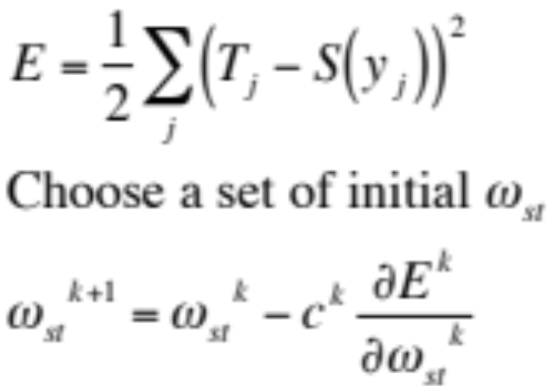
BP – 3-Layer Network
ω_{iq}
Σ_{q}
h_{q}
ω_{qj}
Σ_{j}
y_{j}
S(y_{j})
x_{i}
S_{i}
S_{q}
S_{j}
The problem is essentially “how to choose weight ω to minimize the error between the expected output and the actual output”
The basic idea behind BP is gradient descent
ω_{st} is the weight connecting input s at neuron t

Slide 7
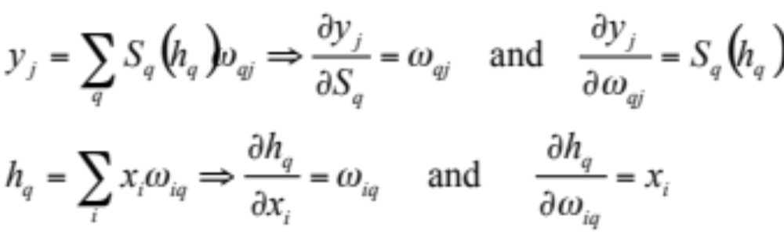
Exercise
ω_{iq}
Σ_{q}
h_{q}
ω_{qj}
Σ_{j}
y_{j}
S(y_{j})
x_{i}
S_{i}
S_{q}
S_{j}

Slide 8
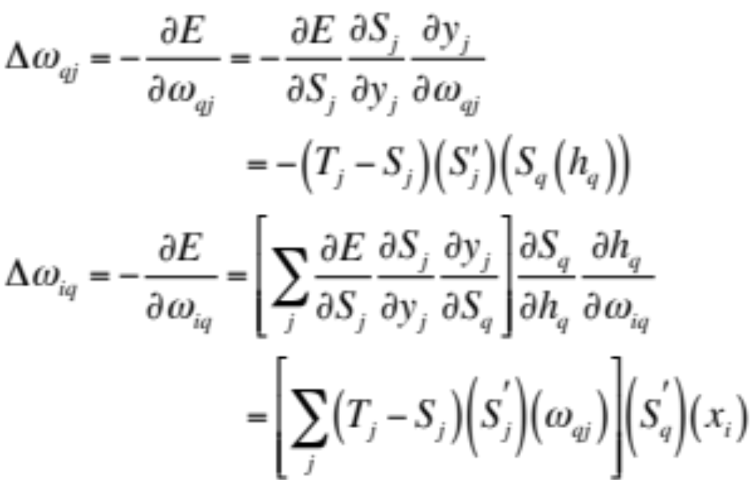
*The Derivative – Chain Rule
ω_{iq}
Σ_{q}
h_{q}
ω_{qj}
Σ_{j}
y_{j}
S(y_{j})
x_{i}
S_{i}
S_{q}
S_{j}

Slide 9
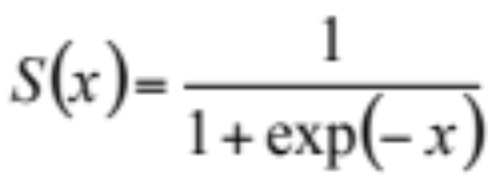
Threshold Function
Traditional threshold function as proposed by McCulloch-Pitts is binary function
The importance of differentiable
A threshold-like but differentiable form for S (25 years)
The sigmoid

Slide 10
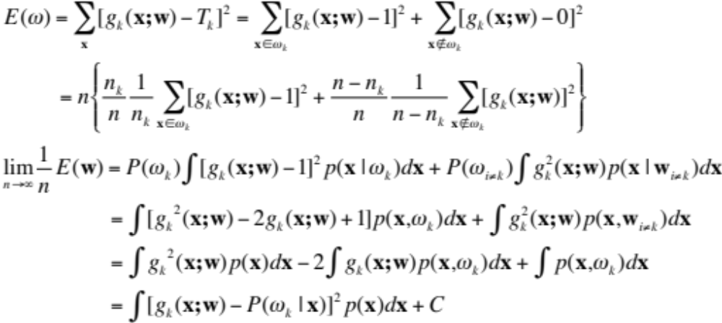
*BP vs. MPP
Notes:
When n goes to infinity, the output of the BP approximates the a-posteriori probability
For last step, +\int P^2(\omega_k|x)p(x)dx - \int P^2(\omega_k|x)p(x)dx+\int p(x).P(\omega_k|x)dx
The last two terms = \int p(x) P(\omega_k|x)(1-P(\omega_k|x))dx

Slide 11
Practical Improvements to Backpropagation

Slide 12
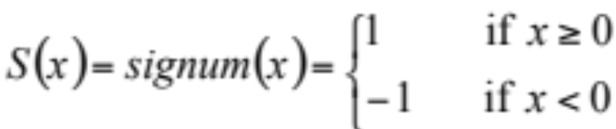
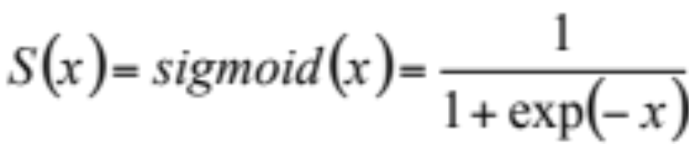
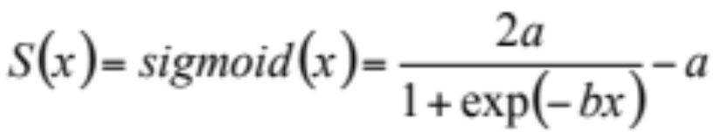
Activation (Threshold) Function
The signum function
The sigmoid function
  Nonlinear
  Saturate
  Continuity and smoothness
  Monotonicity (so S’(x) > 0)
Improved
  Centered at zero
  Antisymmetric (odd) – leads to faster learning
  a = 1.716, b = 2/3, to keep S’(0) -> 1, the linear range is –1<x<1, and the extrema of S’’(x) occur roughly at x -> 2
Notes:
Nonlinear otherwise the 3-layer network provides NO computational power above that of a 2-layer net.
Saturation s.t. the output has minimum and maximum
Continuity and smoothness s.t. the derivative and the function itself exist, s.t. we can use GD to learn
Monotonicity (nonessential): s.t. the derivative would have the same sign to reduce error, otherwise multiple local minima or maxima would occur

Slide 13
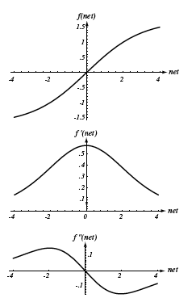
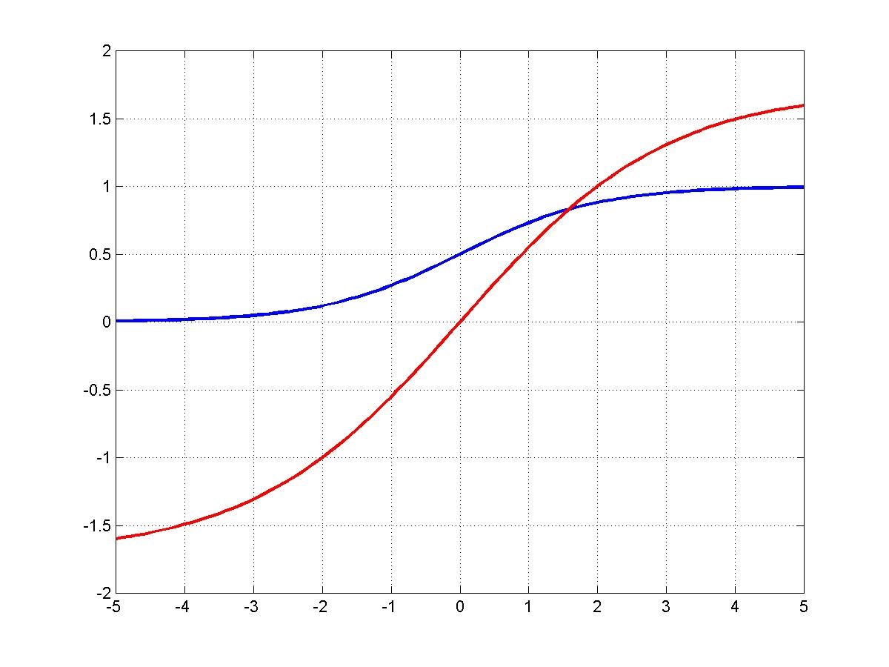

Slide 14
Data Standardization
Problem in the units of the inputs
  Different units cause magnitude of difference
  Same units cause magnitude of difference
Standardization – scaling input
  Shift the input pattern
    The average over the training set of each feature is zero
  Scale the full data set
    Have the same variance in each feature component (around 1.0)

Slide 15
Target Values (output)
Instead of one-of-c (c is the number of classes), we use +1/-1
  +1 indicates target category
  -1 indicates non-target category
For faster convergence

Slide 16
Number of Hidden Layers
The number of hidden layers governs the expressive power of the network, and also the complexity of the decision boundary
More hidden layers -> higher expressive power -> better tuned to the particular training set -> poor performance on the testing set
Rule of thumb
  Choose the number of weights to be roughly n/10, where n is the total number of samples in the training set
  Start with a “large” number of hidden units, and “decay”, prune, or eliminate weights

Slide 17
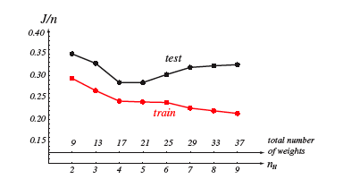
Number of Hidden Layers

Slide 18

Initializing Weight
Can’t start with zero
Fast and uniform learning
  All weights reach their final equilibrium values at about the same time
  Choose weights randomly from a uniform distribution to help ensure uniform learning
  Equal negative and positive weights
  Set the weights such that the integration value at a hidden unit is in the range of –1 and +1
  Input-to-hidden weights: (-1/sqrt(d), 1/sqrt(d))
  Hidden-to-output weights: (-1/sqrt(n_{H}), 1/sqrt(n_{H})), n_{H} is the number of connected units

Slide 19
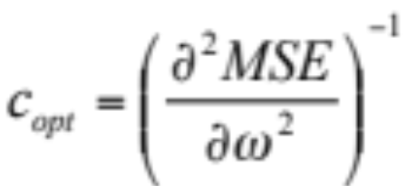
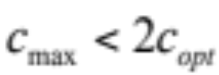
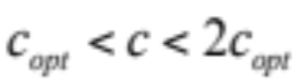
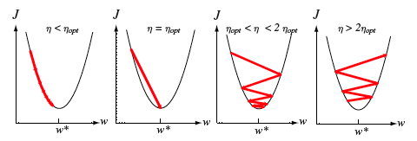
Learning Rate
The optimal learning rate
  Calculate the 2nd derivative of the objective function with respect to each weight
  Set the optimal learning rate separately for each weight
  A learning rate of 0.1 is often adequate
  The maximum learning rate is
  When , the convergence is slow

Slide 20
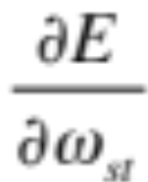
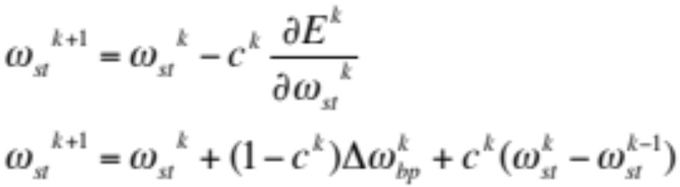
Plateaus or Flat Surface in S’
Plateaus
  Regions where the derivative is very small
  When the sigmoid function saturates
Momentum
  Allows the network to learn more quickly when plateaus in the error surface exist
Notes:
Error surface having too many plateaus
Momentum: Moving objects tend to keep moving unless acted upon by outside forces
When c=0, this is bp
With momentum, smoother learning curve, faster convergence
Recursive or infinite-impluse-response low-pass filter that smooths the changes in w

Slide 21
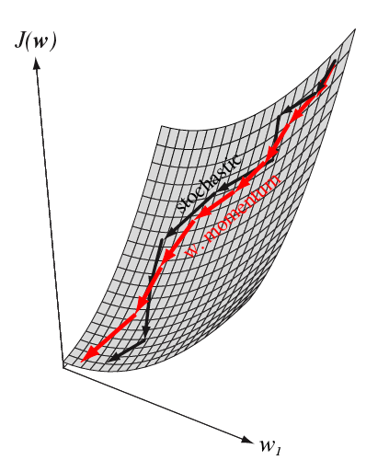

Slide 22
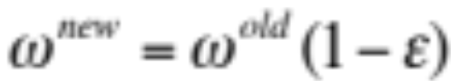
Weight Decay
Should almost always lead to improved performance
Notes:
Weights that are not needed for reducing the criterion function become smaller and smaller

Slide 23
Batch Training vs. On-line Training
Batch training
  Add up the weight changes for all the training patterns and apply them in one go
  GD
On-line training
  Update all the weights immediately after processing each training pattern
  Not true GD but faster learning rate

Slide 24
Other Improvements
Other error function (Minkowski error)

